Slide 1










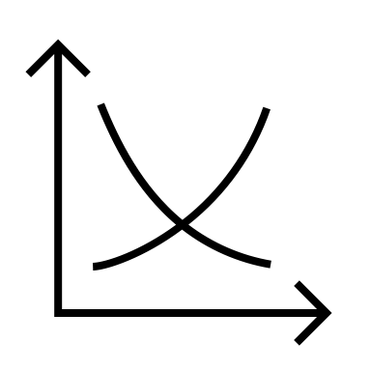


Managerial Economics : News Analysis
BY VIDHI SHARMA
BATCH :- BILL GATES

Slide 2

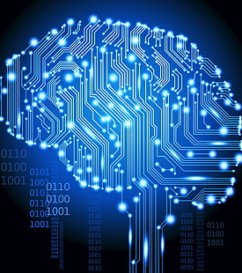

Balancing Act: AI and Employment in India

Slide 3
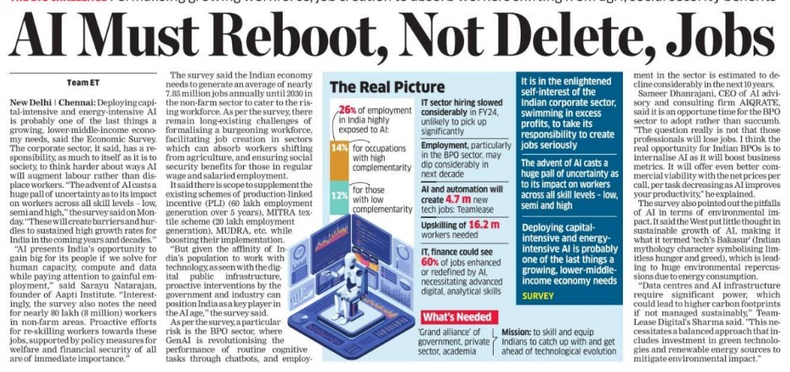

The article highlights the growing concern about AI's potential impact on jobs across different skill levels. It mentions the possibility of job losses in sectors like BPO due to AI advancements.
The article also points out that India can benefit from AI by attracting investments and creating new job opportunities in AI-related fields.

Slide 4
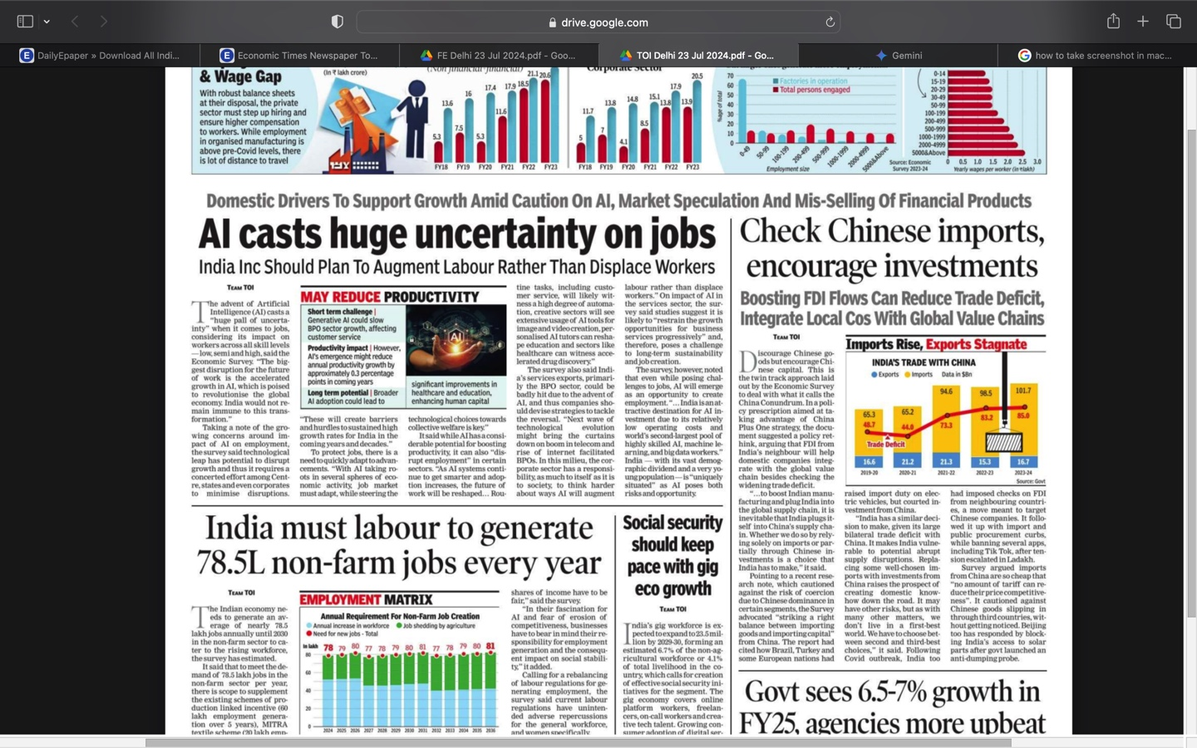

India needs to adapt to the changing job market by focusing on areas where AI can augment human labor rather than replace it.
The article highlights the need for a balanced approach to AI, emphasizing both the challenges and opportunities it presents for India.

Slide 5
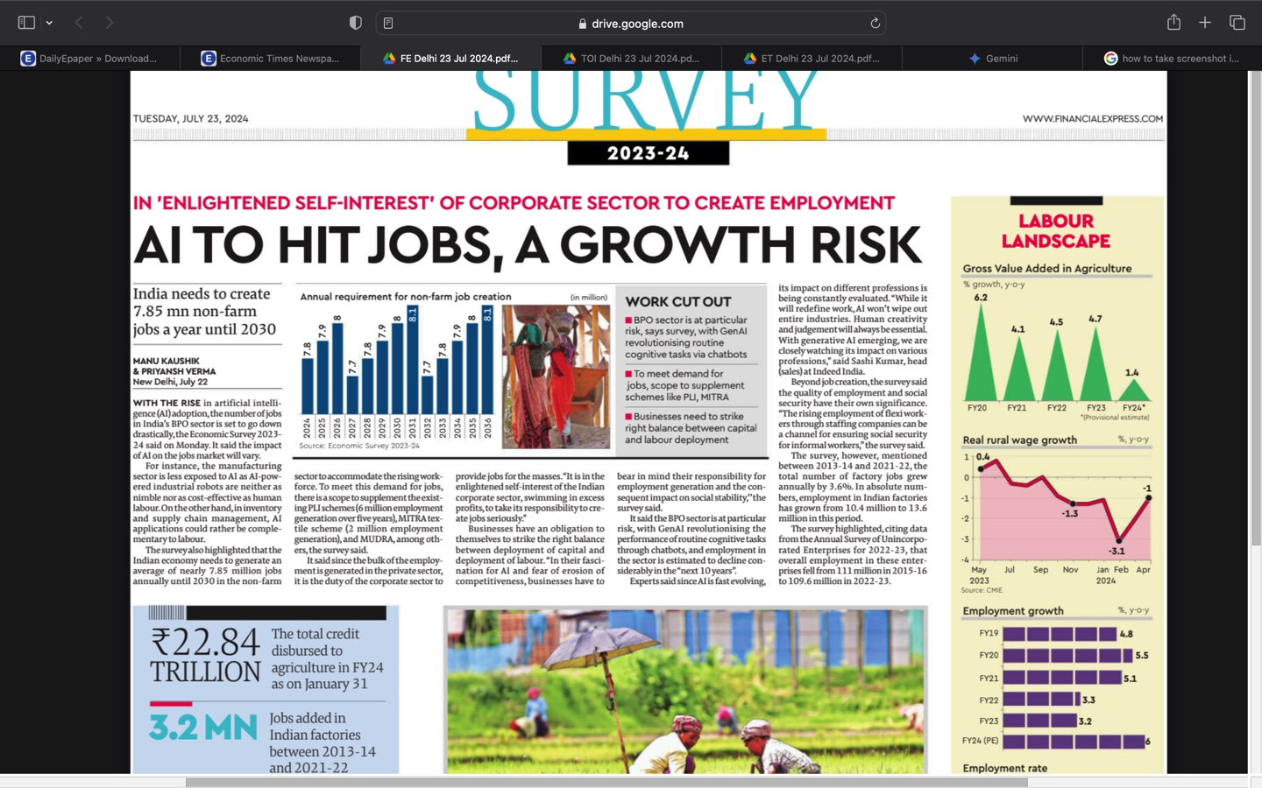
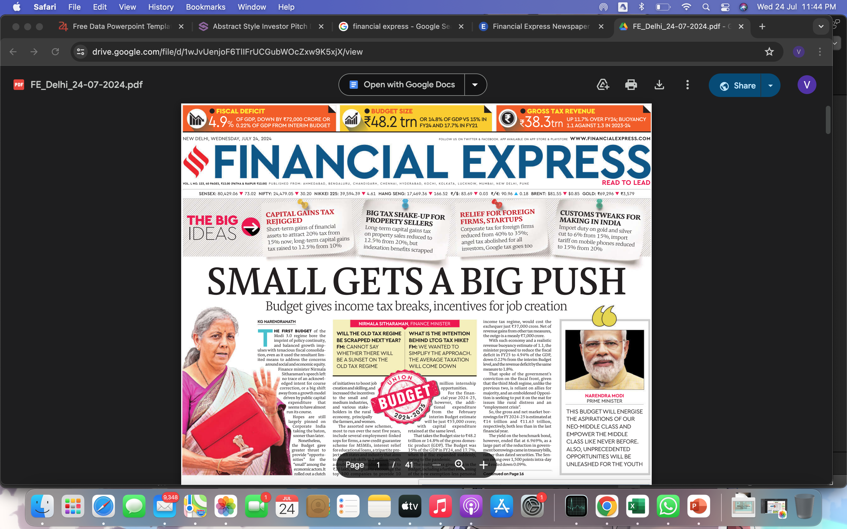
AI is expected to have a significant impact on jobs in India, with the BPO sector being particularly at risk.
The article highlights the need for India to create 7.85 million non-farm jobs per year until 2030.
The article emphasizes the importance of striking a balance between capital and labor deployment.

Slide 6
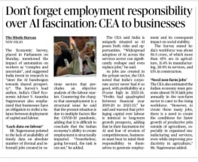

AI has the potential to both create and replace jobs.
It warns that the impact of AI on jobs is complex and uncertain. This means that it is difficult to predict exactly how AI will affect employment levels in different sectors.
India should invest in research to ensure AI benefits everyone.

Slide 7
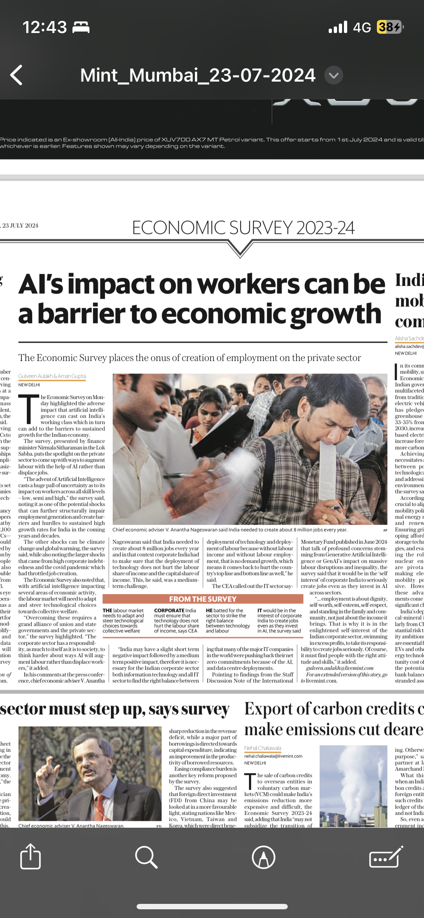
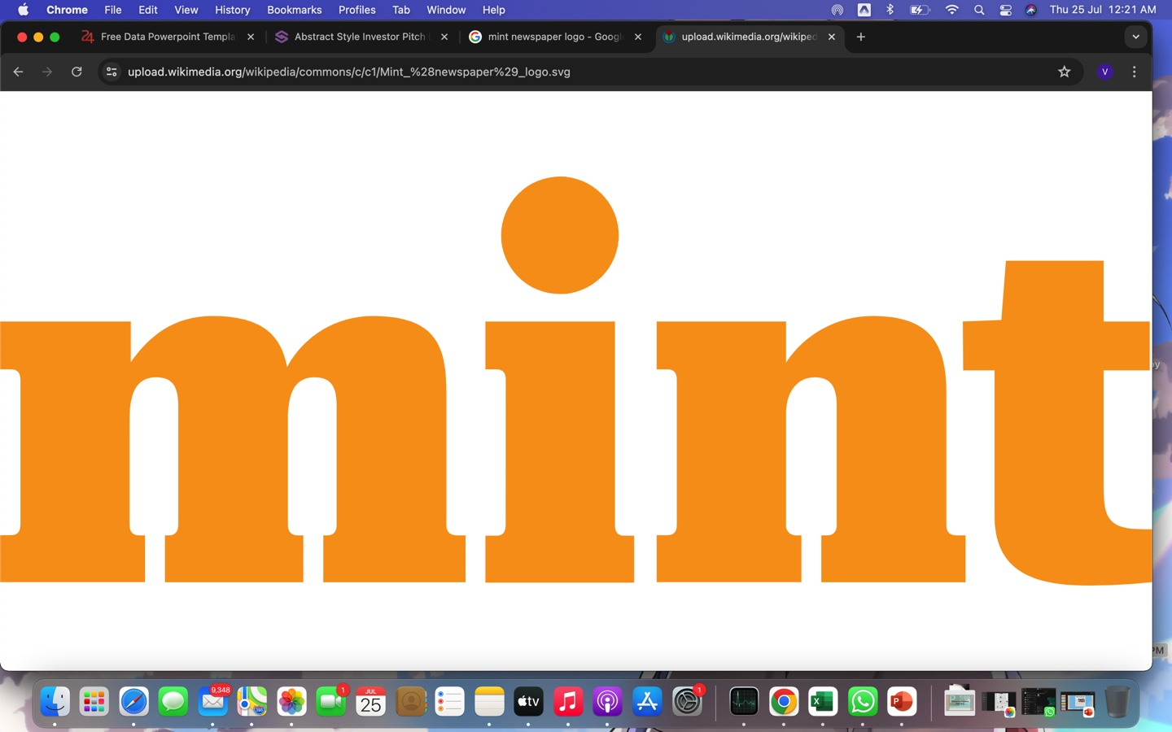
The government calls on the private sector to find ways to use AI to augment labour rather than replace workers.
The Economic Survey emphasizes the importance of a "grand alliance" between government and industry to address this challenge.

Slide 8
SUMMARY
The articles highlight the complex relationship between AI and employment in India. While AI has the potential to create new jobs, it also poses a risk to existing jobs.
There is a need for a collaborative approach between the government, industry, and other stakeholders to mitigate the negative impacts of AI and maximize its benefits for the Indian economy.
The articles emphasizes the need for India to adapt to the changing job market due to AI.
India needs to adapt its workforce and policies to harness AI's benefits while mitigating its negative impacts. The articles emphasizes the need for India to adapt to the changing job market due to AI.
Governments and industries must invest heavily in reskilling and upskilling programs to prepare the workforce for an AI-driven future.

Slide 9
THANK YOU

